Slide 1
Post Graduate Student Union Learning is Fun with Arduino 2017-18
Session-2
Engr S M Asim Ali
School of Computer Science ,
Beihang University

Slide 2
What is a Microcontroller?
“A microcontroller is a very small computer that has digital electronic devices (peripherals) built into it that helps it control things. These peripherals allow it to sense the world around it and drive the actions of external devices.” (Ref. 2)
It is an “embedded computer system” that continuously repeats software (programming) commands
Examples: Arduino Uno, Raspberry Pi, etc.

Slide 3
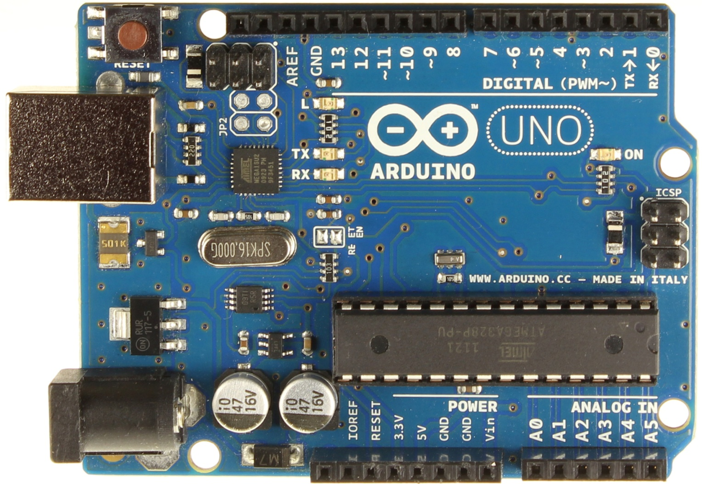
Arduino Uno
Digital
(Input/Output) Pins
USB Connector
Battery Connector
Analog
(Input) Pins
Power Pins

Slide 4
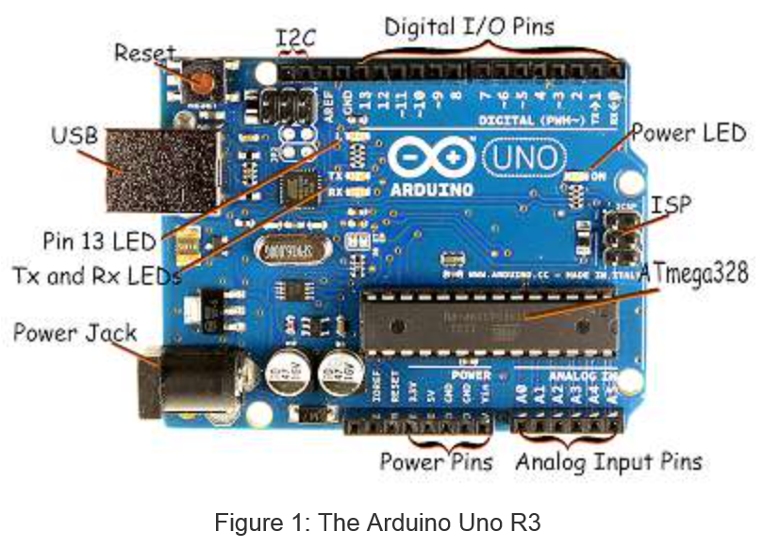
Arduino Uno – more details (Ref. 2)

Slide 5
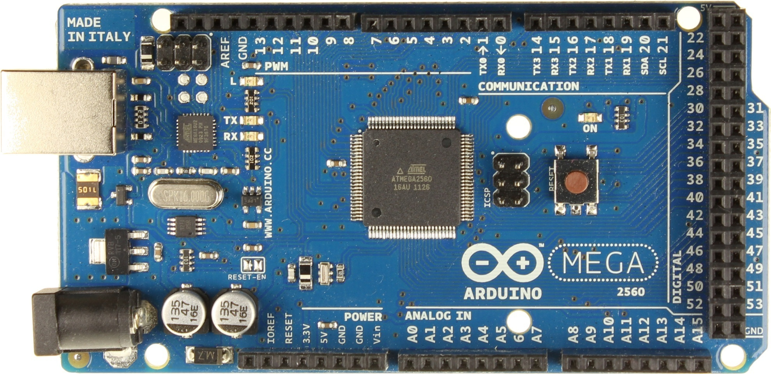
Arduino Mega – Larger, more pins (we won’t be using this today)
USB Connector
Serial Pins
Digital Pins
Battery Connector
Power Pins
Analog Pins

Slide 6
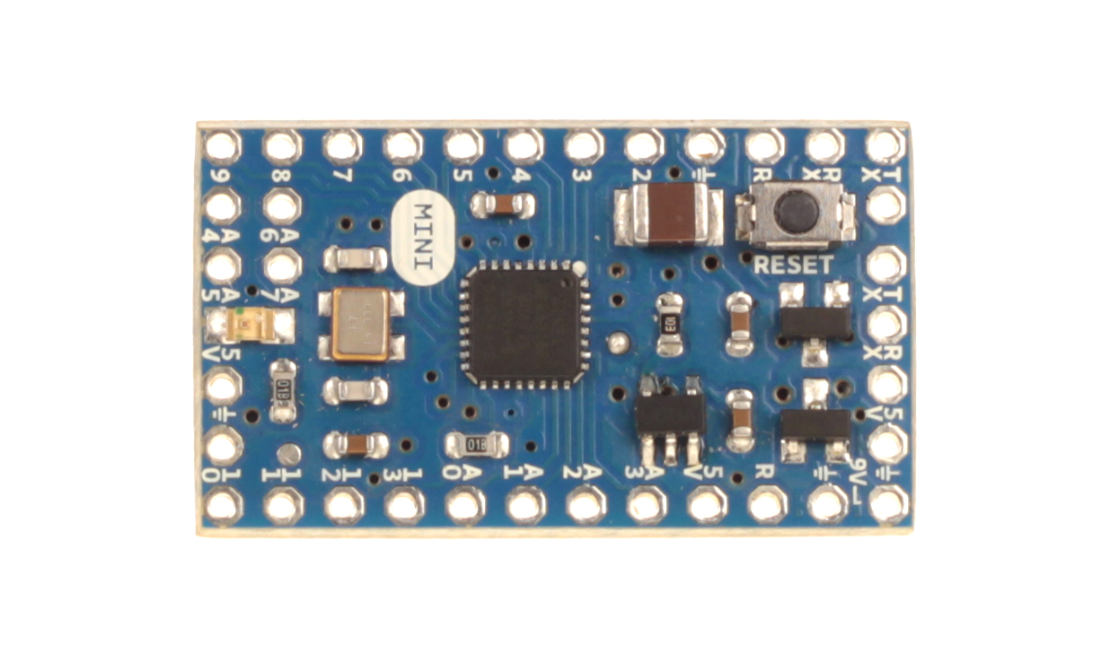
Arduino Mini (smaller)
Digital Pins
Serial Connectors
Analog Pins
Power Pins

Slide 7
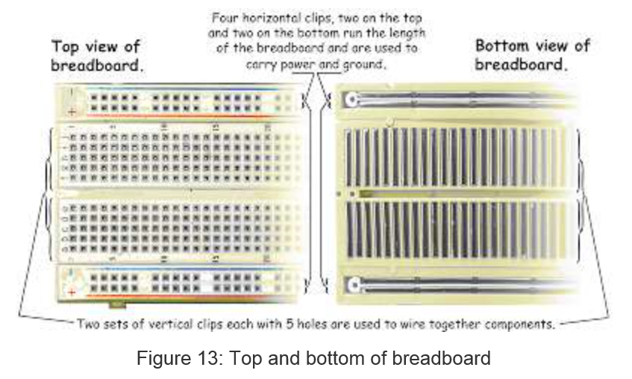
(Solderless) Breadboard (Ref. 2)

Slide 8
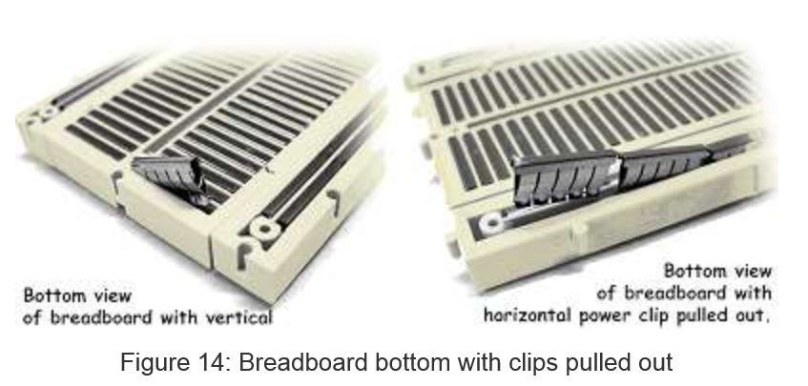
Breadboard Innards (Ref. 2)
Insert 22-gauge solid wire jumpers and component leads into breadboard clips to make
electrical connections without soldering. Use the edge “rails” for power (5V) and ground.

Slide 9
Introduction to Software
Arduino microcontrollers are programmed using the Arduino IDE (Integrated Development Environment)
Can be downloaded for free from http://arduino.cc/en/Main/Software
Arduino programs, called “sketches”, are written in a programming language similar to C and C++
Every sketch must have a setup() function (executed just once) followed by a loop() function (potentially executed many times); add “comments” to code to make it easier to read (technically optional, but actually required (by me))
Many sensors and other hardware devices come with prewritten software – look on-line for sample code, libraries (of functions), and tutorials

Slide 10
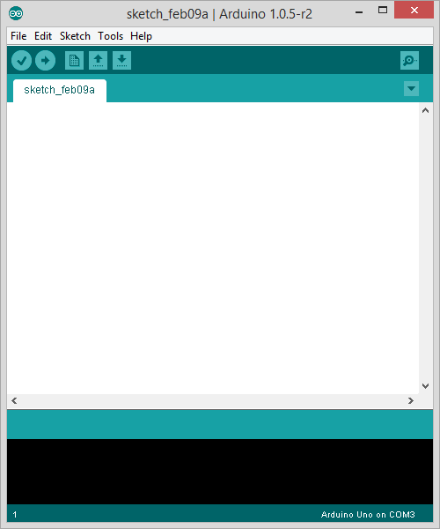
Parts of the IDE main screen
Name of current sketch
Main menus
Action buttons/icons
Text area for
writing/editing
sketches.
Verify (AKA compile)
Upload (send to Arduino)
Start a new sketch
Open a sketch (from a file)
Save current sketch (to a file)
Open Serial Monitor window
Error messages and other
feedback show up here.

Slide 11
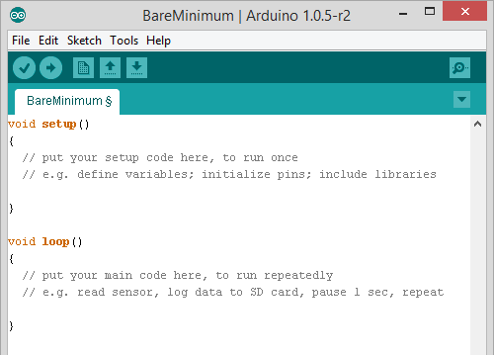
BareMinimum – sketch organization

Slide 12

Activity 1 – making an on-board and external LED blink
Place an LED on the breadboard (don’t put both legs into a single (connected) column)
Wire the LED’s negative (shorter) lead to a 560 Ohm “safety resistor” then wire the other end of the resistor to ground (GND)
Wire the LED’s positive (longer) lead to digital Pin 13 on the Arduino
Plug in the Arduino with the USB cable and run the Arduino IDE software on the computer
Under Tools:Board make sure Arduino Uno is selected
Under Tools:Serial Port select the correct COM port (e.g. COM3)
Under File:Examples:01Basics select the Blink sketch
Look at the code. Note delay(1000) waits 1000 millisec = 1 second
Verify (AKA Compile) the code , then Upload it to the Uno – notice that it runs immediately (and will re-run if you power cycle) – the sketch will stay in the Uno memory until overwritten or erased
Discuss how the sketch works (in general terms: setup(), loop(), liberal use of comments); digital HIGH is 5V and LOW is 0V (ground)
This is an example of “control (output) using digital pin 13”

Slide 13
About Motors
There are several different types
Standard DC motor - input current for full continuous rotation. No special pins or wiring.
Standard servomotor (AKA servos) - Motor capable of limited rotation (generally 180°) in precise degree increments. Uses Servo library in Arduino. Have 3+ pins. Controlled by pulse-width modulation (“~” pins)
Continuous rotation servo – can go all the way around continuously. Interprets PWM value as speed & dir.
Stepper Motors - Servo capable of full rotation in small steps. Uses Stepper library in Arduino. Have 3+ pins
We are using a standard servo in this lesson.

Slide 14
Activity 2: Using a Servo
With the Arduino Uno unplugged, wire up the servo according to the chart on the next slide
Load the sketch Servo.ino
Take a look at the code and note the commands used to drive the servo. The comments should help you understand what each does.
Be careful – Some servos use a lot of power and may need an external power source.
Notes:
Servos use the library Servo.h
Only a few simple commands: attach, read, write
Our servos only go 180°
Can modify to spin 360°(Have to disassemble the motor and modify gears, not that easy)
Often better to use a stepper motor for full rotation
Can have it go specific degree increments
Disables analogWrite() on pins 9 and 10

Slide 15
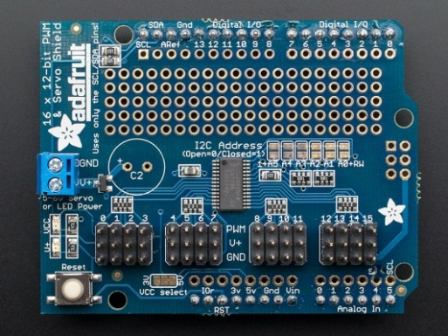
Servo
Pin | Description | Attached To
Brown | Ground | GND
Red | Power (5V) | 5V
Orange | Control Lead | D3
Note that the servo has a plug attached to its ribbon cable. This is so that we can more easily extend the cable using plugs and more ribbon cable. It also allows it to plug into specific plugs built into some shields. Several companies make a few different Motor Shields, which are shields specifically designed to drive servos, motors, and stepper motors. These usually support 2 to 4 motors, although Adafruit has one that will control 16. They generally have plugs built into the shield for the motors and often drive them through some sort of a serial connection (I2C or SPI is common).
Right: Adafruit Motor Shield
http://www.adafruit.com/products/1411

Slide 16
To Sweep or Not to Sweep
In many applications it might not be necessary to use a “sweep” sketch, where the servo sweeps between angles in incremental small steps.
Another way may be to set the servo to just “open” (go to one angle) and “close” (go to another angle). This might be easier to code than “sweep.”

Slide 17
Note about Libraries:
Libraries take large amounts of code and refine it into a few simple commands we can use. Ex: datalog.print will print something to a file.
This actually takes a lot of code, but by putting it in a library we can ignore the basic code and focus on the useful commands and functions
Usually ends in a .h (header file)
Used in our programs by the #include command: #include "SD.h"
Almost everything that is not analog (digital sensors, servos, etc) use a library of some sorts (Many use the same library-ie. Wire)
You can install more libraries into your IDE. Look under Sketch:Import Library to see which ones you have.
Ex: “SD.h”, SoftwareSerial.h, Wire.h, OneWire.h, “RTClib.h”

Slide 18
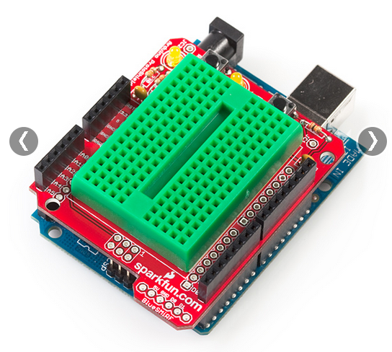
Proto shield & “tiny” breadboard
We are not using the proto shield today, but they can be seen in your kit.
Notice that this “tiny” solderless breadboard (ours are white) has no power rails and very limited real-estate. Use it wisely!

Slide 19
A few words on sensors
The rest of the lesson will focus on how to use various sensors to make measurements and how to “log” (record) those values to an SD card.
Sensors can be broken into two major categories:
Analog sensors
Based on changing the voltage of the sensor
Can only use analog inputs (A0, A1, etc)
Generally easier to program and use
Not as accurate & easily interfered with by other electronics (noise in voltage)
Digital Sensors:
Usually use digital pins
Can use more advanced forms of communication to let multiple sensors share the same pins (sometimes even using analog pins)
Generally more difficult to program and wire up; often need libraries and significantly more code for each type of sensor used
Most advanced sensors (GPS, IMU, etc) are digital – this is the best way to pass more data between sensor and microcontroller quickly & efficiently

Slide 20
About Digital Sensors:
Digital Sensors run at two major voltages: 3.3V and 5V
Always check to be sure you are providing the correct voltage. If you send a 3.3V sensor 5V it is very easy to blow it out.
Watching for pin conflicts and voltage discrepancies is par for the course when using microcontrollers. If you aren’t careful you can get bad data, fry components, or possibly even damage the microcontroller itself. Also watch out for components that look alike (e.g. the analog temp sensor and the digital temp sensor). Also remember that most components require specific orientations; almost all, except resistors and some types of capacitors.

Slide 21
Activity 3 – Wiring and logging sensor data
Sensors involved:
Micro-SD card shield
Data LED indicator (tells whether the SD card is logging data (steady flash) or not (multi-flash (indicating an error))
Analog temperature sensor
Digital 3-axis magnetometer sensor

Slide 22
Micro SD Shield and Data LED Indicator
Plug the micro-SD shield directly onto an unpowered Arduino Uno. All the legs must go straight into the header – don’t bend any.
Wire an LED using the tiny breadboard:
- Positive (long) end wired to a safety resistor. Other end of resistor connects to digital pin 5.
- Negative (short) end wired to ground.

Slide 23
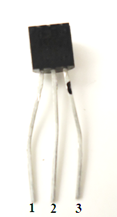
Analog Temperature Sensor
With the Arduino Uno unpowered, wire the TMP 36 sensor using the table below
Pin | Function | Attached To
1 | 5V (Power) | 5V pin
2 | Analog Output | Pin A2
3 | Ground | GND pin
This 3-pin sensor has TMP written on it. This is called a T0-92 package.
Make sure the flat side of the sensor has TMP written on it!
Check the orientation!
Note: The photo shows flat side facing you.

Slide 24
Digital 3-Axis Magnetometer
With the Arduino unplugged, add the Digital 3 Axis Magnetometer to your breadboard using the table below:
The magnetometer can be combined with an accelerometer (and maybe gyros) to make an IMU (Inertial Measurement Unit)
Not perfect - a magnetometer can be interfered with by magnets, metals, and other electronic devices (good IMUs can account for interference to some degree)
Pin | Function | Attached To
VCC | Power Input (3.3V) | 3.3V
GND | Ground | GND
SDA | Serial Data Line (I2C Bus) | A4
SCL | Serial Clock Line (I2C Bus) | A5
INT | Interrupt Pin | Not Connected

Slide 25
Logging the Data
Open the sketch Temp_Mag_Log.ino
As you can see in the code setup, data logging can be a bit complex.
Most of the time you can directly copy the code from the setup loop used for the SD card
A few details to keep in mind:
Must do all reading/writing of data in the main loop.
We included a special piece of code to write a new file each time the Arduino is powered. Without this, it would overwrite our old data
Pins can change depending on the SD card reader you use. Sparkfun MicroSD Shield uses D8 and D10-13.

